Slide 1
OpenStack based storage system from Fujtisu
András Pulai
architect
mailto: andras.pulai@ts.fujtisu.com

Slide 2
OpenStack

Slide 3
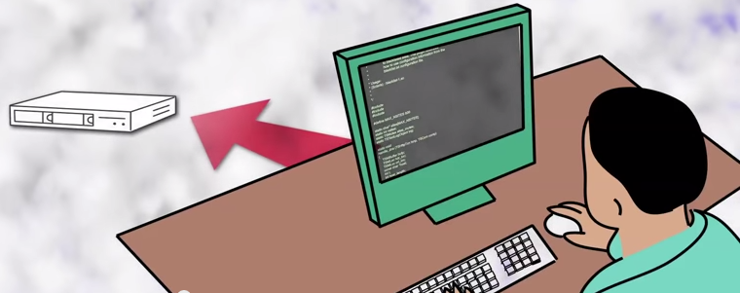
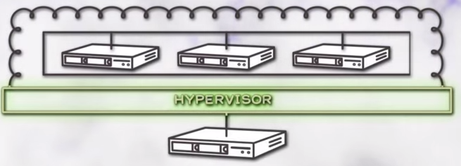
Why openstack ? What is the Problem?
Developers pointed applications directly to servers
new APP = new SERVER
Result: huge underutilized serverfarms
Racking, Networking, procurment
Solution: add a Hypervisor layer
Notes:
Hozta a problémákat, beszerzés, rackbe építés, hálózat kialakítása, stb

Slide 4
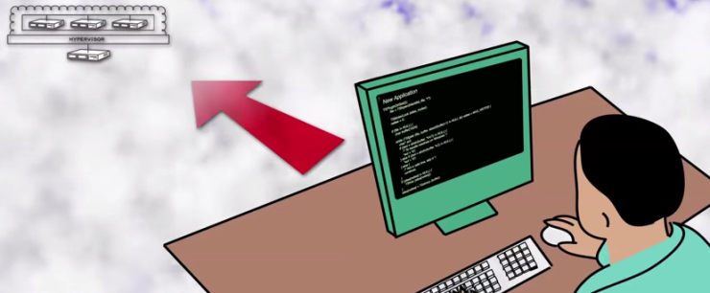
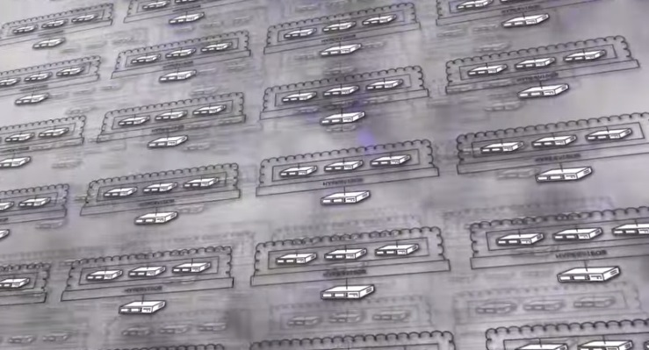
Virtualization helped – and caused another pb.
Developers pointed applications directly to VMs
…
Complexity in managing virtualization layer
VM’s still managed like traditional physical servers
No possiblility for automation

Slide 5
Traditional vs „smart” applications
Today’s IaaS/Cloud
vApps – New or legacy OS
vCloud – Manage Cloud
vCenter – Manage VM
Network – High Availability
Storage – High Availability
OpenStack
Apps – new type of intelligent Apps / Cloud – Web ready
„Nova” - Compute API services
start/stop/provision a node
„Neutron” - Network API services
„Swift” – Storage API, object based
Notes:
Régen amikor elkészítettek egy alkalmazást, annak fogalma sem volt arról, hogy milyen infrastrukúra van alatta.
Ahhoz, hogy ezek az alkalmazások megbízhatóan működjenek nagyon erősen körülbástyázták ezeket az alkalmazásokat
Nagy megbízhatóságú storage, storage replikáció, pillanatfelvételek, automatikus útvonal választás
Network – több útvonalon érjünk el mindent / különböző routing protokollok
vCenter – és a tetejére úgyanúgy építettünk egy clustert, vagy fizikailag manageltük a gépeket
Könnyebb volt, de úgy néz ki van tovább lépés
Mindig sokat gondolkoztam azon, hogyan működik a google, a gmail, a facebook
Azt sejetettem, hogy máshogy mint azok az Oracle clusterek amiket régen építettem, vagy alkalmazások amiket clustereztünk
Most nézzünk egy új fejlesztést, egy újfajta alkalmazást, egy web vagy felhő szerű alkalmazást
Aki tudja, hogy a gépek csak arra várnak hogy elromolhassanak
Aki tudni akar a környezetéről
Ez nem a hello world, notepad alkalmazás
Ez az openstack API lehetővé teszi, hogy az API-n keresztül kérjen az alkalmazás szolgáltatásokat változásokat az infrastruktúrában
Pl indítsunk el új példányokat
Konfigjuk be hozzá a hálózatot
A VMware vApp is a collection of pre-configured virtual machines (VMs) that combine applications with the operating systems that they require.

Slide 6
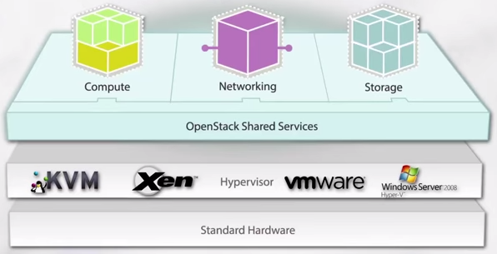
OpenStack = Control layer
Consume resources from one point, one dashboard
The way you access these resources is unified
A Cloud Operating System
Complexity of management goes away
Notes:
Az OpenStack rétegre mint egy vezérlő rétegre érdemes gondolni

Slide 7
How to Simplify a computing cloud?
Simplify
Open Source Driven
Vmware (incl. vCenter, vCloud)
Hyper-V (incl. System Center VM Mgr)
OpenStack
Storage Virtualisation
(FalconStor, Datacore, SVC, …)
ETERNUS CD10000
Notes:
Megint hasonlítsunk egy ismert dolgot egy újhoz

Slide 8
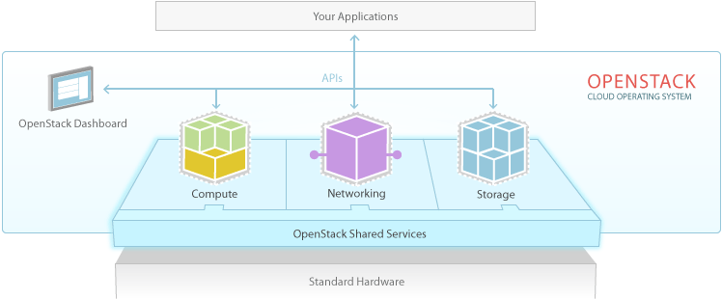
OpenStack components - APIs
Compute (Nova)
Computing fabric controller
Works with BareMetal, HPC and virtualization technologies (Vmware, Hyper-V)
Object Storage (Swift)
OpenStack Object Storage is a scalable redundant storage system.
OpenStack software responsible for ensuring data replication and integrity across the cluster
Block Storage (Cinder)
OpenStack Block Storage provides persistent block-level storage devices for use with OpenStack compute instances.
Works with Ceph, local Linux storage (LVM), GPFS
Networking
OpenStack Networking (Neutron, formerly Quantum) is a system for managing networks and IP addresses
Notes:
Compute (Nova)[edit]
OpenStack Compute (Nova) is a cloud computing fabric controller, which is the main part of an IaaS system. It is designed to manage and automate pools of computer resources and can work with widely available virtualization technologies, as well as bare metal and high-performance computing (HPC) configurations. KVM, VMware, and Xenare available choices for hypervisor technology, together with Hyper-V and Linux container technology such as LXC.^{[26][27]}
It is written in Python and uses many external libraries such as Eventlet (for concurrent programming), Kombu (for AMQP communication), and SQLAlchemy (for database access).^{[28]} Compute's architecture is designed to scale horizontally on standard hardware with no proprietary hardware or software requirements and provide the ability to integrate with legacy systems and third-party technologies.
Object Storage (Swift)[edit]
OpenStack Object Storage (Swift) is a scalable redundant storage system. Objects and files are written to multiple disk drives spread throughout servers in the data center, with the OpenStack software responsible for ensuring data replication and integrity across the cluster. Storage clusters scale horizontally simply by adding new servers. Should a server or hard drive fail, OpenStack replicates its content from other active nodes to new locations in the cluster. Because OpenStack uses software logic to ensure data replication and distribution across different devices, inexpensive commodity hard drives and servers can be used.
In August 2009, Rackspace started the development of the precursor to OpenStack Object Storage, as a complete replacement for the Cloud Files product. The initial development team consisted of nine developers.^{[29]} SwiftStack, an object storage software company, is currently the leading developer for Swift.^{[citation needed]}
Block Storage (Cinder)[edit]
OpenStack Block Storage (Cinder) provides persistent block-level storage devices for use with OpenStack compute instances. The block storage system manages the creation, attaching and detaching of the block devices to servers. Block storage volumes are fully integrated into OpenStack Compute and the Dashboard allowing for cloud users to manage their own storage needs. In addition to local Linux server storage, it can use storage platforms including Ceph, CloudByte, Coraid, EMC (ScaleIO, VMAX and VNX), GlusterFS, Hitachi Data Systems, IBM Storage (Storwize family, SAN Volume Controller, XIV Storage System, and GPFS),Linux LIO, NetApp, Nexenta, Scality, SolidFire, HP (StoreVirtual and 3PAR StoreServ families) and Pure Storage. Block storage is appropriate for performance sensitive scenarios such as database storage, expandable file systems, or providing a server with access to raw block level storage. Snapshot management provides powerful functionality for backing up data stored on block storage volumes. Snapshots can be restored or used to create a new block storage volume.

Slide 9
What is Ceph ?
Ceph is a free software storage platform
present object, block, and file storage from a single distributed computer cluster
main goals
to be completely distributed without a single point of failure,
scalable to the exabyte level, and freely-available.
The data is replicated, making it fault tolerant
runs on commodity hardware
self-healing and self-managing
CRUSH - Controlled, Scalable, Decentralized Placement of Replicated Data

Slide 10
How object storage works?
Horizon Mngmnt UI
Open Source Driven
OpenStack
Object Storage API
Nova Compute API
Ceph object gateway
VMware / Xen / Hyper-V
ETERNUS CD10000
X86 Based Server
with internal disks
VM image 1
Ephemeral / temporary VM storage
VM image N
Notes:
Megint hasonlítsunk egy ismert dolgot egy újhoz

Slide 11
How block storage works?
Horizon MngMnt UI
Open Source Driven
OpenStack
Block storage API
Ceph block device
Nova Compute API
Xen / Docker
ETERNUS CD10000
X86 Based Server
Block Ios sent down to Ceph
VM image 1
VM image N
Notes:
Megint hasonlítsunk egy ismert dolgot egy újhoz

Slide 12
OpenStack / ETERNUS CD10000 (Ceph)
OPEN STACK
Identity API KEYSTONE API
Object Storage API SWIFT
Block Storage API CINDER API
GLANCE API
NET API NOVA
HYPERVISOR (Qemu/KVM)
CEPH OBJECT GATEWAY (RGW)
CEPH BLOCK DEVICE
(RBD)
CEPH STORAGE CLUSTER
(RADOS)

Slide 13
What is inside the ETERNUS CD10000?
VMs
REST
More to come
Application
Interface
ETERNUS CD10000
Block Level Access
Object Level Access
File Level Access
Fujitsu Software
Central Management
Ceph Storage System S/W
Open Source
Performance Nodes
Capacity Nodes
10GbE Frontend Network
Fujitsu Standard Hardware
Infiniband Backend Network

Slide 14
ETERNUS CD10000 – Building Blocks
Basic Storage Node
Performance Node
Capacity Node
12.6TB
PRIMERGY RX300 S8
34.2TB
PRIMERGY RX300 S8
ETERNUS JX40
252.6TB
PRIMERGY RX300 S8
ETERNUS JX60
Up to 224 Storage Nodes with > 56 PB

Slide 15
ETERNUS CD10000 Principles
transparent creation of data copies
automatic recreation of lost redundancy
Storage
Node
Storage
Node
Storage
Node
Storage
Node
Storage
Node
Storage
Node
pseudo-random distribution
automated tech refresh

Slide 16
Network (non-redundant, up to 23 nodes)
Infiniband Switch
1 per node
4-23 Storage Nodes

Slide 17
Network (redundant, up to 224 nodes)
Infiniband Root Switch 1
Infiniband Root Switch 2
Infiniband Root Switch 3
Infiniband Root Switch 4
2x
2x
2x
2x
8x
Leaf-Switches 1/2
28 Storage Nodes
Leaf-Switches
3/4
28 Storage Nodes
Leaf-Switches
5/6
28 Storage Nodes
Leaf-Switches
7/8
28 Storage Nodes
Leaf-Switches
15/16
28 Storage Nodes

Slide 18
How ETERNUS CD10000 Overcomes the Scalability Bottleneck
Fish become disks ☺
Direct disk access without central instance

Slide 19
ETERNUS CD10000 Software Architecture
Cluster Monitors
<10
cluster membership
authentication
cluster state
cluster map
Meta Data Server (MDS)
10s
for POSIX only
Namespace mgmt.
Metadata ops (open, stat, rename, …)
Object Storage Daemons (OSD)
10,000s
stores all data / metadata
organises all data in flexibly sized containers
Topology
Authentication
POSIX
meta data only
bulk data traffic
block file object
Clients

Slide 20
ETERNUS CD10000 vs. Plain Ceph

Slide 21
ETERNUS CD10000 vs. Plain Ceph: Lifecycle Management

Slide 22
Typical Lifecycle Management Issues
First node definitions still manageable, but
limited server lifetime
non matching lifetime of components
HDD, HBAs, CPU/mainboard, …
fast innovation speed
CPU, HDDs, …
negative quality impact by exploding node variants
issues multiply with new software versions
FW, OS, Ceph
enterprise class deployments need Q/A
how to upgrade a larger cluster without risking a disaster?

Slide 23
ETERNUS CD10000 Lifecycle Management
The solution is always a combination of a hardware release („S1“) and a software version („V1“)
A hardware release includes
a defined set of nodes
internal network, external interfaces
planning & configuration rules for system growth (rack placement, cable lengths, …)
A software release supports a defined set of hardware releases
Service packs complement the lifecycle management
provide bug fixes
but can also provide new software functions
can also support new hardware elements (e.g. a new node type)

Slide 24
ETERNUS CD10000 Lifecycle Management
Old components need to be phased out / replaced after a reasonable lifetime (max. 5 years) in order to
receive continued solution maintenance
benefit from future software functions
Within these boundaries Fujitsu offers
a quality assured combination of hardware and software
a component oriented and selective upgrade scheme
introduction of new nodes, phase out of old ones
rolling software upgrades

Slide 25
ETERNUS CD10000 vs. Plain Ceph Deployment & Administration

Slide 26
Typical Administration Tasks & Challenges
Add new nodes
Handle node failures
Handle OSD failures
Central monitoring
Problem analysis
Challenges
does not only involve Ceph
tasks involve HW, OS, and Ceph
special treatment of SSDs, Ceph journals
experienced people needed to operate a Ceph cluster

Slide 27
Example: Replacing an HDD
Plain Ceph
taking the failed disk offline in Ceph
taking the failed disk offline on OS / Controller Level
identify (right) hard drive in server
exchanging hard drive
partitioning hard drive on OS level
Make and mount file system
bring the disk up in Ceph again
On ETERNUS CD10000
vsm_cli <cluster> replace-disk-out <node> <dev>
exchange hard drive
vsm_cli <cluster> replace-disk-in <node> <dev>

Slide 28
Example: Adding a Node
Plain Ceph
Install hardware
Install OS
Configure OS
Partition disks (OSDs, Journals)
Make filesystems
Configure network
Configure ssh
Configure Ceph
Add node to cluster
On ETERNUS CD10000
Install hardware
hardware will automatically PXE boot and install the current cluster environment including current configuration
Make node available to GUI
Add node to cluster with mouse click on GUI

Slide 29
Fujitsu Centralised Management
Central software deployment
Central network, logfile, and cluster management
SNMP integration of all nodes and network components
GUI for easier deployment, configuration, administration and maintenance
Remote support / maintenance via AIS Connect
Still 100% compatible with underlying open source







Slide 30
ETERNUS CD10000 Summary

Slide 31
In a Nutshell …
ETERNUS CD10000
Cloud Storage Solution
based on industry standard servers …
… and a bunch of disks
(no RAID ☺)
supporting up to 224 nodes with > 56 PB
hold tgether by hyperscale storage software
E2E H/W-S/W integration, add-ons, & service by

Slide 32
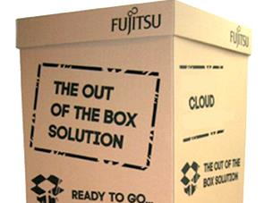
ETERNUS CD10000 = Ceph++
Cloud Storage
+
Hardware / Software Integration by Fujitsu
up to 224 nodes with > 56 PB
+
E2E Solution Contract by Fujitsu
based on Red Hat Ceph Enterprise
+
Lifecycle Management for Hardware & Software by Fujitsu
+
Easy Deployment / Management by Fujitsu

Slide 33
Who Should Be Interested Now?
Everybody with rapidly changing application environments
Everybody in need for rapid application deployment
Datacentres losing applications to the cloud
Datacentres starting with OpenStack
Everybody considering object storage as alternative to scale out NAS

Slide 35
OpenStack.org User Survey Nov. 2014
669 Responses
Production Usage
46% in 2014
32% in 2013
Top Drivers (>40%)
Ability to innovate (47%)
Open technology (47%)
Cost savings (46%)
Avoiding vendor lock-in (45%)
Operational efficiency (41%)

Slide 36
OpenStack.org User Survey Nov. 2014
Storage Driver (Production)
Ceph (37%)
LVM (23%)
Glusterfs (10%)
NetApp (10%)
NFS (7%)
EMC (4%)
Hypervisors (Production)
KVM (87%)
VMware (6%)
Xen (3%)
Hyper-V (1%)

Slide 37
Who is using OpenStack ?
Cisco WebEx US On-Premise Private Cloud
PayPal US On-Premise Private Cloud
Yahoo US On-Premise Private Cloud
NSA US ?
CERN CH Hybrid Cloud
Wigner Data Center HU Hybrid Cloud
Nextserver Ltd HU On-Premise Private Cloud
http://www.openstack.org/user-stories/
Notes:
Ez a dia egy kis kitérőt jelent
Ki használ openstack alapú számítási környezetet

