Slide 1
Librarians + Elsevier: empowering you and your users https://www.elsevier.com/librarians
Presenter: Cseplész Anita Regional Account Manager Central Europe
April 1 2016
Notes:
Links to the resources and services in this presentation can be found at https://www.elsevier.com/librarians. Be sure to bookmark the page!

Slide 2
MAY THE FORCE BE WITH YOU!

Slide 3
Agenda
As a librarian, you want to:
Tell value stories to management and users
Use technology to save time
Offer valuable services to your users
Stay up-to-date on critical information
Continually upgrade your skills
Elsevier can help!

Slide 4
Tell value stories to management and users

Slide 5
Holdings
https://www.elsevier.com/solutions/sciencedirect/support/holdings-and-usage-reports
Notes:
Explain to management where their access comes from, how librarians select collections and what collections they have

Slide 6
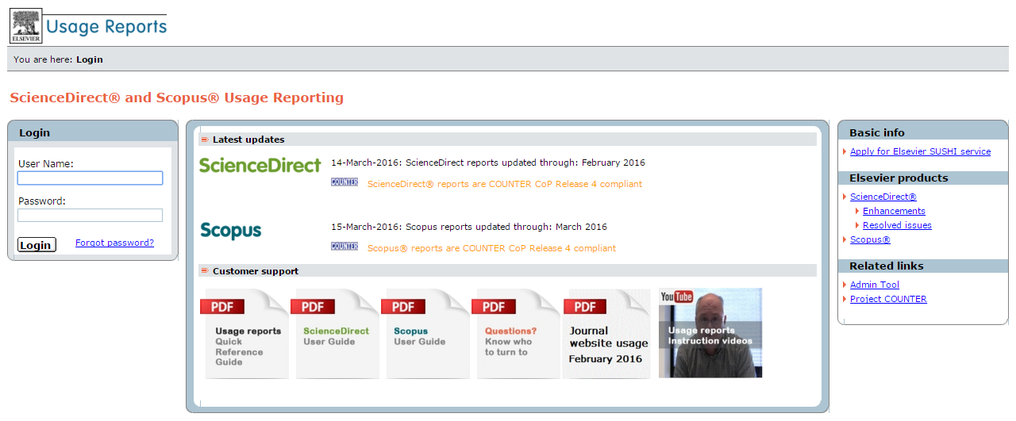
Usage
http://usagereports.elsevier.com/asp/main.aspx

Slide 7
Playing “Moneyball” in Librarianship: The Winning Strategy of Gap Analysis
https://www.elsevier.com/books-and-journals/books/moneyball/whitepaper
Notes:
Data, driving high-quality decisions, can be a powerful vehicle for change. By empowering librarians with fact-based analytics, their libraries can become more prominent and valuable. Such “gap analysis” provides librarians greater visibility into usage behavior, as well as their institution’s and the world’s research trends – allowing librarians to provide greater access to the content library patrons want, and elevate their own stature within an institution.

Slide 8
Use technology to save time

Slide 9
Automation options to enhance discovery
Websites
Federated search
Text & data mining
Institutional repositories
https://www.elsevier.com/solutions/sciencedirect/support/automated-content-integration

Slide 10
ScienceDirect APIs
Article Entitlement Retrieval
Article Recommendation Retrieval
Article Retrieval
Authentication
Enhancement Fragment Retrieval
Holdings Report
Non-serial Title
Object Retrieval
Object Search
ScienceDirect Search
Serial Title
Subject Classifications
APIs can be used to:
Update institutional repository
Update holdings in discovery services
Perform text mining
And more!
“Elsevier has taken a lead role in helping libraries improve user access to electronic resources. They were the first to develop these APIs which help time-strapped librarians deliver up-to-date resources. This proactive API serves as a model for other publishers.”
— Carlen Ruschoff, Director, Technical Services and
Strategic Initiatives, University of Maryland

Slide 11
Scopus APIs
Abstract Citation Count
Citation Overview
Serial Title
Subject Classifications
Abstract Retrieval
Affiliation Retrieval
Author Retrieval
Author Search
Scopus Search
https://www.elsevier.com/solutions/scopus/features/api

Slide 12
eBooks Savings Calculator
http://libraryconnect.elsevier.com/ebooks-savings-calculator
Notes:
How much can you save by converting your print books to electronic books? Enter a few quick values in the calculator to get an estimate.

Slide 13
Offer valuable services for your users

Slide 14
Researchers have ambitions and challenges
“I love being a researcher because I have an insatiable curiosity and the ambition to make a difference”
“Today’s fast-changing market requires me to be more competitive and collaborative. Empower me to stand out and make a difference!”

Slide 15
Serving all entities: Social Network of Science
Institutions
Research groups
Labs
Journals
Funding bodies
Publishers
Patent offices
Societies
Conferences
Notes:
Build the foundation, get top researchers on it, connect the Elsevier ecosystem

Slide 16
Notes:
Help your authors with their promotion and tenure files by giving them valuable information about the performance of their articles.

Slide 17
Journal metrics
Apply to over 20,000 journals, proceedings and book series:
Are refreshed once per year
Eliminate the risk of manipulation
Can correct for citation behavior and database coverage (SNIP and SJR)
Provide multidimensional insights into journal performance
Can allow for a direct comparison of journals, independent of their subject classification (SNIP and SJR)
Are publicly accessible and are integrated into the Scopus Journal Analyzer
http://www.journalmetrics.com/
Notes:
Help your authors decide where to publish

Slide 18
Scopus Article Metrics Module
Notes:
Help your authors with their promotion and tenure files by giving them valuable information about the performance of their articles.

Slide 19
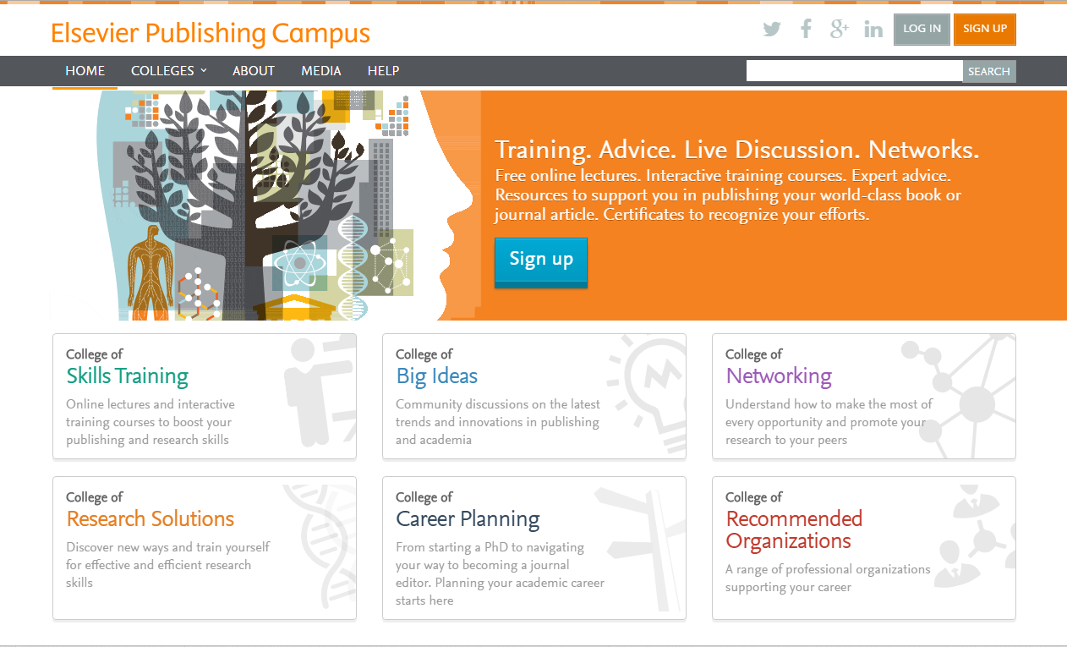
Elsevier Publishing Campus
https://www.publishingcampus.elsevier.com
Notes:
Free online lectures. Interactive training courses. Expert advice. Resources you can use to assist your grad students and junior faculty in publishing. Certificates to recognize their efforts.

Slide 20
Mendeley (https://www.mendeley.com/)
Manage references
Read and annotate
Generate citations and bibliography
Share reading lists, articles or references
Create public and private groups
Write papers collaboratively
Showcase your work
Connect with colleagues
Follow others
Notes:
Sign up for free, or get even more space and groups with Mendeley Institutional Edition. I’ll talk about the Certification Program for Librarians in the next section

Slide 21
Product Toolkits, Brochures & Promotion
Videos
Animated PPT loops for monitors
Logos & descriptions for library website/catalog
Email templates
Quick reference guides
Webinars
Fact sheets
https://www.elsevier.com/librarians
Notes:
On the Librarians page on Elsevier.com you’ll find links for the various products

Slide 22
Online product support resources
https://www.elsevier.com/solutions/sciencedirect/support
https://www.elsevier.com/solutions/scopus/support

Slide 23
Stay up-to-date with issues of importance to your institution

Slide 24
Policies
Accessibility
Article withdrawal
Copyright
CrossMark
Custom publications
Digital archive
Editorial independence
InterLibrary Loan
Hosting Content
Open access licenses
Patient consent
Pricing
Privacy
Research data
Sharing articles
Text and data mining
https://www.elsevier.com/about/company-information/policies
Notes:
Sharing policy is available as a handout

Slide 25
Open Access
1,700+ Elsevier journals offer both open access and subscription publishing options
In 2015, Elsevier was the 4th largest open access publisher, with 20,000 open access (author or funder paid) articles
Elsevier publishes 104 open archive journals.
https://www.elsevier.com/about/open-science/open-access

Slide 26
Mendeley Data (https://data.mendeley.com/)
Notes:
Help researchers comply with sharing mandates. Make research data citable -- DOIs and versioning following Force11 guidelines

Slide 27
eBooks on ScienceDirect
http://onlinebooksconnect.elsevier.com/
Notes:
Newsletter for librarians specifically about eBooks on ScienceDirect

Slide 28
Continually upgrade your skills

Slide 29
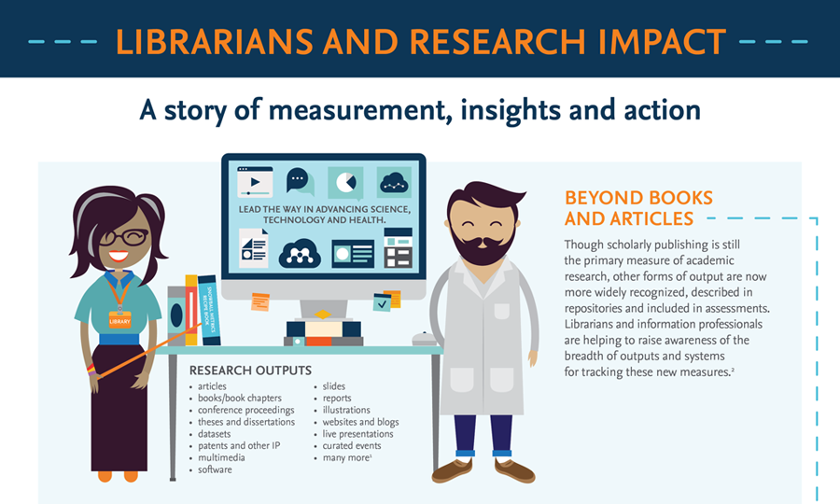
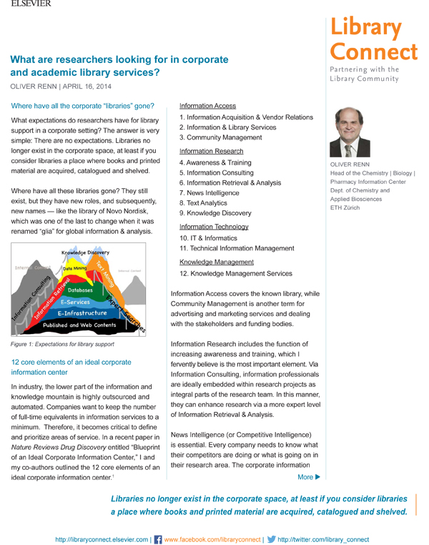
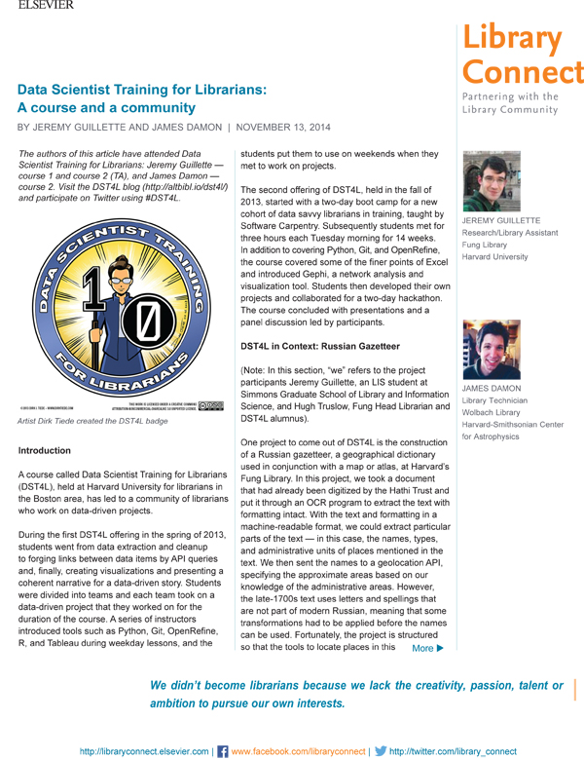
More than
33,000 subscribers
in 175 countries
Academic, corporate, medical and government librarian authors
Elsevier partners with librarians to create LIS resources and share knowledge through:
Library Connect Newsletter
Sign up for a complimentary subscription: http://libraryconnect.elsevier.com/subscribe
Library Connect Webinars
Register for upcoming webinars: http://libraryconnect.elsevier.com/library-connect-webinars
Library Connect Social
Join the LIS community on: Twitter, Facebook, SlideShare, LinkedIn
Library Connect Live Events
Talk to your regional customer marketing team about events in your area
Content includes
articles, infographics
ebooklets and more
Over
13,000 followers
on social media
Average webinar has
1,400
viewers
Explore
LIS best practices
technology, tips and trends
Live events feature experts discussing local issues
Social content curated from premier LIS sources
Notes:
Library Connect is a global program from Elsevier for academic, medical, corporate and government librarians and information professionals. The program includes a free enewsletter, webinars, seminars and symposia, and interactive news channels, including Facebook and Twitter. SUBSCRIBE to the Library Connect Newsletter, which is published as an enewsletter 10 times per year, linking to content on the Library Connect website. The newsletter features librarian authors sharing LIS best practices, how-tos, technology, tips and trends. REGISTER for a Library Connect webinar.

Slide 30
Mendeley Certification for Librarians
Level | Topic | Benefit | Approx. Time
1 | Get to know Mendeley | Join "Certified Librarians" Mendeley group with premium-access upgrade, previews of upcoming product releases | 2-6 hours
2 | Dive deeper into Mendeley | Box of Mendeley materials to help spice up your training sessions* | 4-8 hours
3 | Promote Mendeley | 1 year Mendeley upgrade for 500 users** | 2-6 hours
Annual Refresher | New features and LIS topics | Maintain certification status and continue premium access | 4 hours (attendance at 3 sessions, each 60-90 minutes)
*Limited to two Level 3 rewards per institution per year **Limited to one Level 3 rewards per institution per year
https://www.elsevier.com/solutions/mendeley/support/mendeley-certification-program
Notes:
Learn as much as possible about Mendeley so you can confidently train others

Slide 31
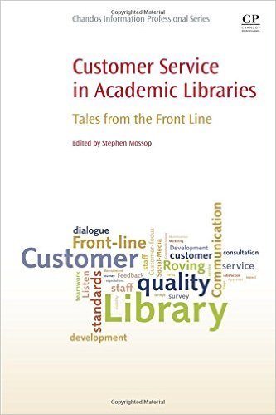
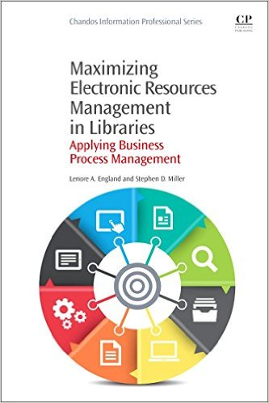
Chandos LIS books and Elsevier LIS journals
Government Information Quarterly
Information Processing & Management
Information and Organization
International Journal of Information Management
Journal of Academic Librarianship
Journal of Informetrics
Journal of Strategic Information Systems
Library and Information Science Research
Telecommunications Policy
World Patent Information
https://info.sciencedirect.com/books
https://www.elsevier.com/social-sciences/library-and-information-science

Slide 33
Questions? Thank You! a.cseplesz@elsevier.com Mobil: +36703310359

